Slide 1
PREDICTING CUSTOMER CHURN: HOW TO BE MORE PROFITABLE BY RETAINING CUSTOMERS
By Michael Presidente
Data Analyst

Slide 2
Why is Customer Churn Important?
Customer churn, also known as customer attrition, occurs when customers stop buying goods or services from a company that has regularly provided a specific product or service. Companies are interested in identifying segments of customers that may terminate their agreements because the price for acquiring a new customer is usually higher than retaining the old one.
2

Slide 3
How much revenue?
If Telstra lost 25% of their estimated 7.9 million mobile customers in 2018, then 316,000 costumers would have changed service providers. The loss of revenue, based on 2017 average monthly spends, could be conservatively estimated at $14.8 million.
If customer retention was improved by 5%, Telstra could save $3.9 million or reduce possible losses by approximately 37%
Source: Whose spending the most on phone plan?
3

Slide 4
Who is interested in reducing churn?
Customer Relation Managers
Customer Engagement Managers
Business Development Managers
Customer Experience Managers
Accounts Managers
Marketing Coordinator
4

Slide 5
HOW CAN CUSTOMER CHURN BE PREDICTED?
The Data Science Pipeline
Source data:
Snapshot of Customer Billing Data
Source:
IBM
Adjusting the pipeline for assessment of customer churn for production
Raw data:
A snapshot of customer billing data with 20 features
Prepare Data:
Add missing values,
Add the Tenure Group Feature
Model Customer Churn:
SckiLearn Models
Gradient Boost
MLP Classifier
Interprete
ML Models :
Select which customers willl churn with LIME
5
Notes:
3 minutes -

Slide 6
What does the Customer Data Look Like?
Customer Information:
Gender, SeniorCitizen, Partner, Dependents
Service Information:
PhoneService, MultipleLine, InternetService, OnlineSecurity, OnlineBackup, DeviceProtection, TechSupport, StreamingTV, StreamingMovies
Customer Account Information:
CustomerID, Contract, PaperlessBilling, PaymentMethod, MonthlyCharges, TotalCharges, Tenure
6

Slide 7
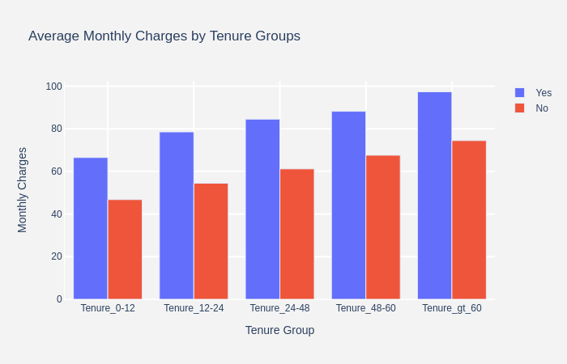
Processing the Data – Adding Features for Better Predictions
7

Slide 8
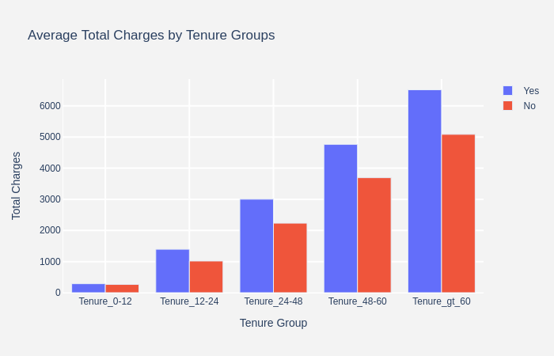
Processing the Data – Confirming Predictions

Slide 9
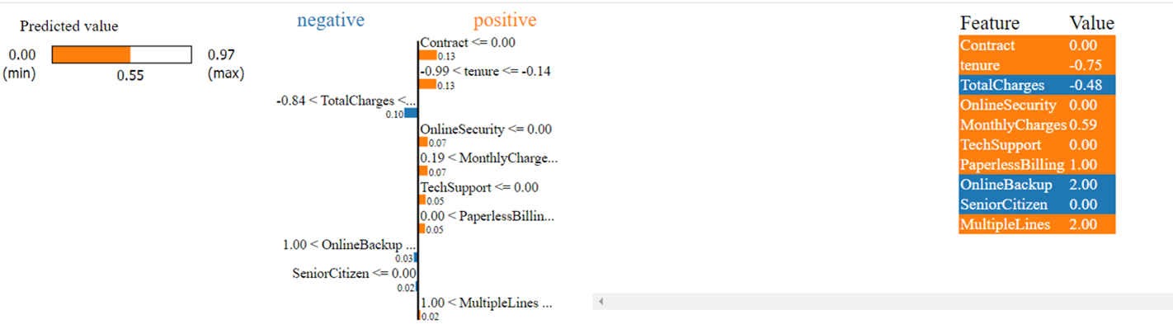
What factors are related to customer churn?
The 10 most significant variables for a customer: LIME Explainer - Logistic Regression Model
9

Slide 10
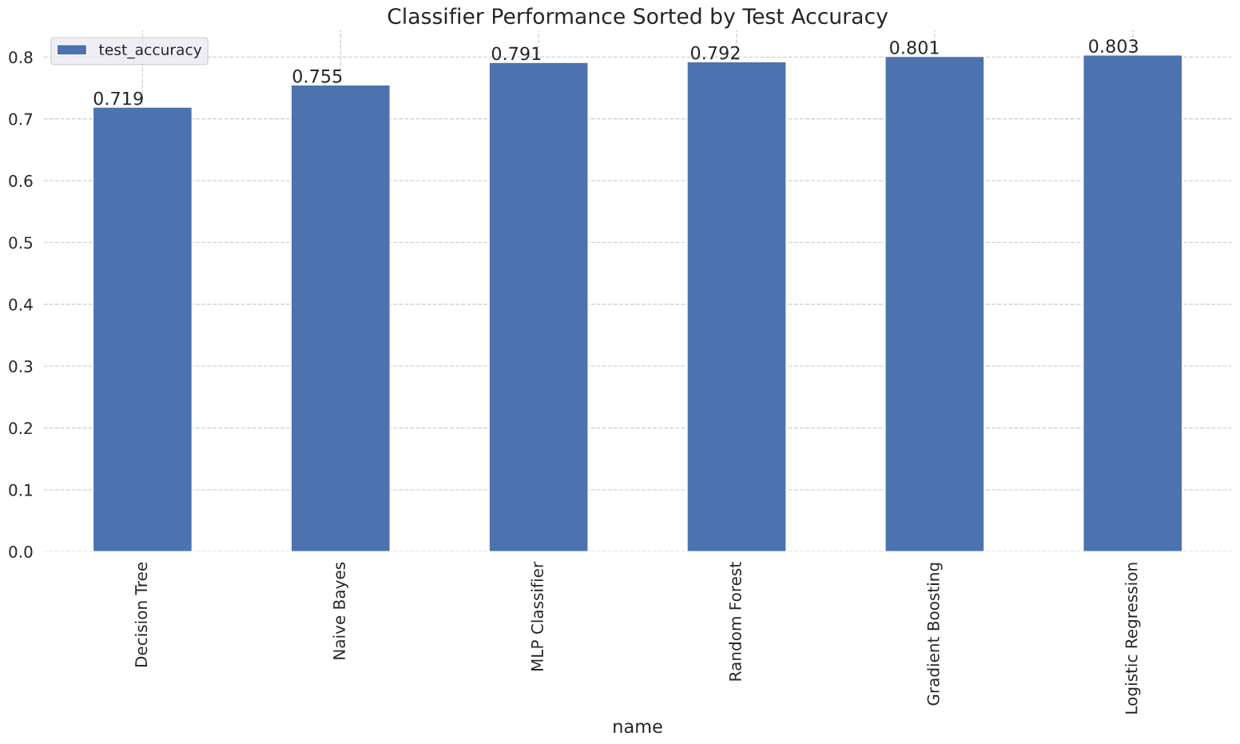
How Accurate are Machine Learning Models?
10

Slide 11
What is the best strategy to retain customers?
Review the customer data: Is the right data being collected?
Develop an effective ML Strategy: How can data be used to determine better customer engagement strategies?
Next Steps:
Begin developing new customer metrics: Example: customer lifetime value
11
Notes:
Emphasis – Time Series

Slide 12




The ML Pipeline in Production
Customer Usage
Data
• Snapshot billing status
• Time series usage
Risk Scores
Weekly scores for
all active customers
Model Explaining:
• LIME algorithms
• Explain the scores
at customer level
Identify Customer likely to Churn
• Trust the model predictions
• Easy to start the conversion
• Take action to retain customers
Machine Learning Models:
• Scikit learn models
• Deep neural networks
12

Slide 13


How could this solution work in production?:
Business :
Initiate a customer retention program is a specific initiative or set of initiatives designed to increase customer value and encourage them to re-purchase. The first stage is to contact customers and open a dialog about available services.
Improve Customer Retention :
Data Science :
Develop a Customer Scorecard:
Prototype an application that easily visualises a customer’s risk of churning. An online application can be developed with open source data science tools that is cost effective to implement.
13

Slide 14
Questions?
Answers to the specific questions around customer churn
14

